Slide 1
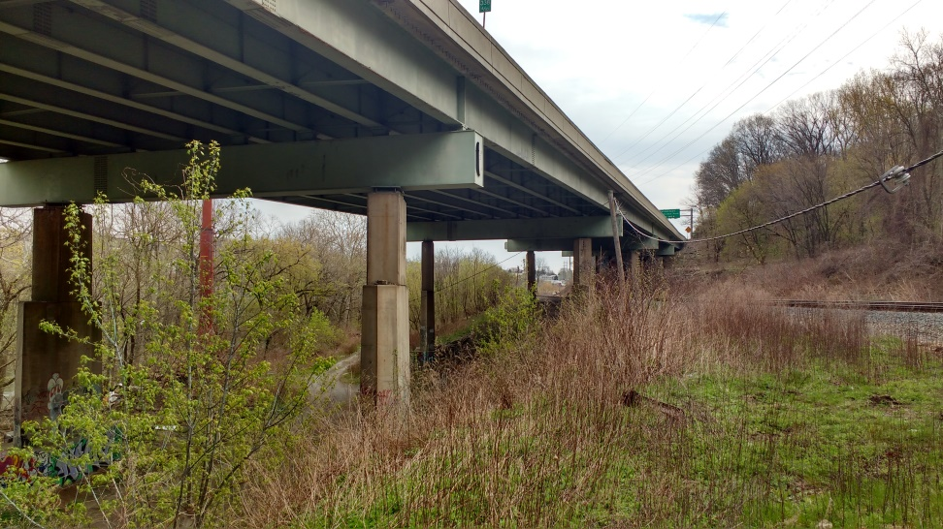
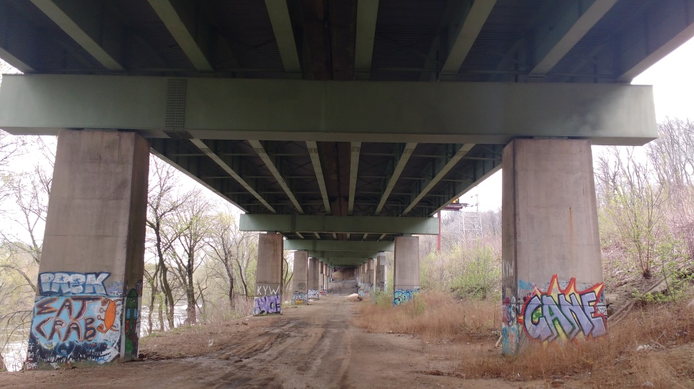
I76 Vibration Study
2 Stage Test
1st Phase – Longitudinal Survey
Instrument Piers
Lateral Acceleration
Short Duration
2nd Phase – Monitoring Section
Instrument Representative Section
Acceleration of Superstructure
Characterize Structure

Slide 3
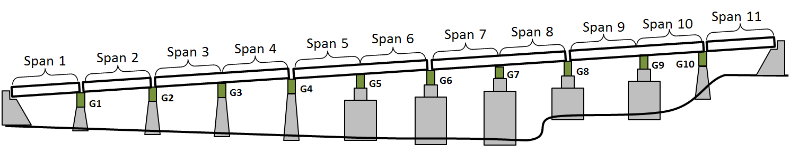

Slide 4
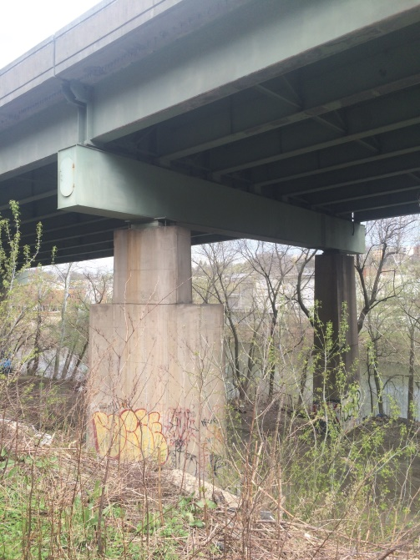
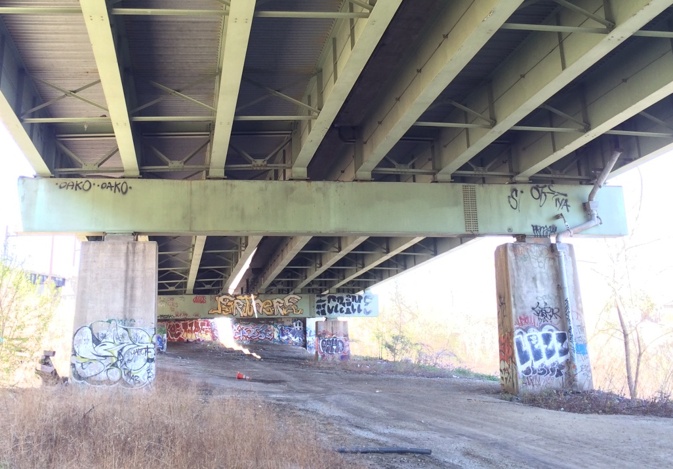
Phase 1
Span 7
Span 8
Span 9
Span 10
Span 4
Span 5
Span 6
Span 3
G10
G7
G8
G9
G4
G5
G6
G2
G3
Test Design to Avoid Traffic Control
4 Continuous Sections of interest
Accel. placed on side of piers (lateral)
Access provided with ladders
Record vibration for several hours
Determine “liveliest” section
If negligible difference:
Choose section most conducive to testing
Otherwise choose “liveliest” span

Slide 5
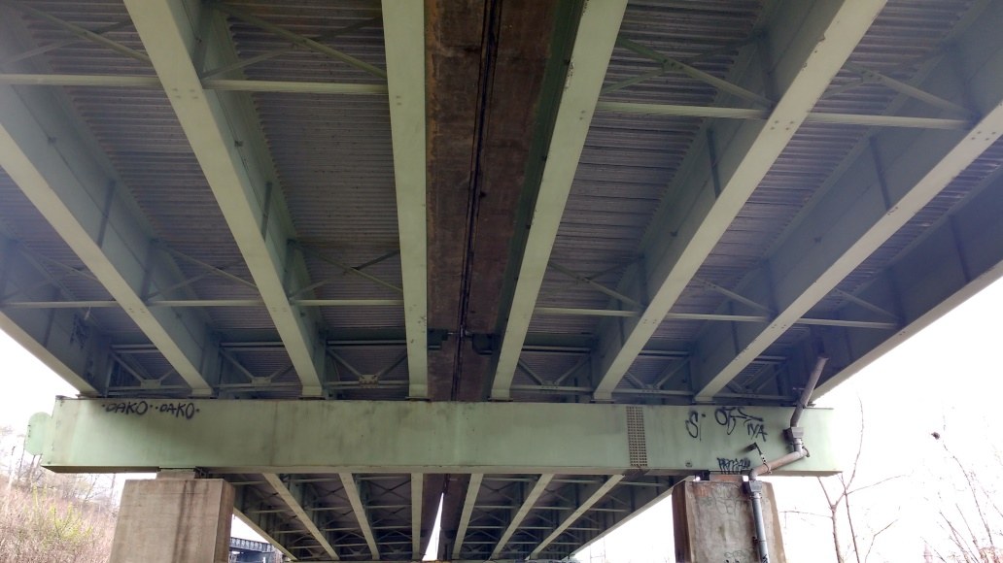
Phase 2
Extended Vibration Study
32 Accelerometers on Girders
Record for several days
Capture vibration characteristics
Monitor vibration amplitude
Correlate with traffic via video
St-ID with FE modeling
Identify possible methods to mitigate vibration discernable by public

Slide 6
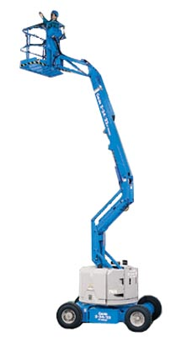
I76 Requirements
Phase 1:
Complete construction documents, inspection reports, CAD drawings
Phase 2:
Aerial Lift
2 days install
1 day breakdown
Power
Video camera capturing traffic
60 Feet Minimum

Slide 7
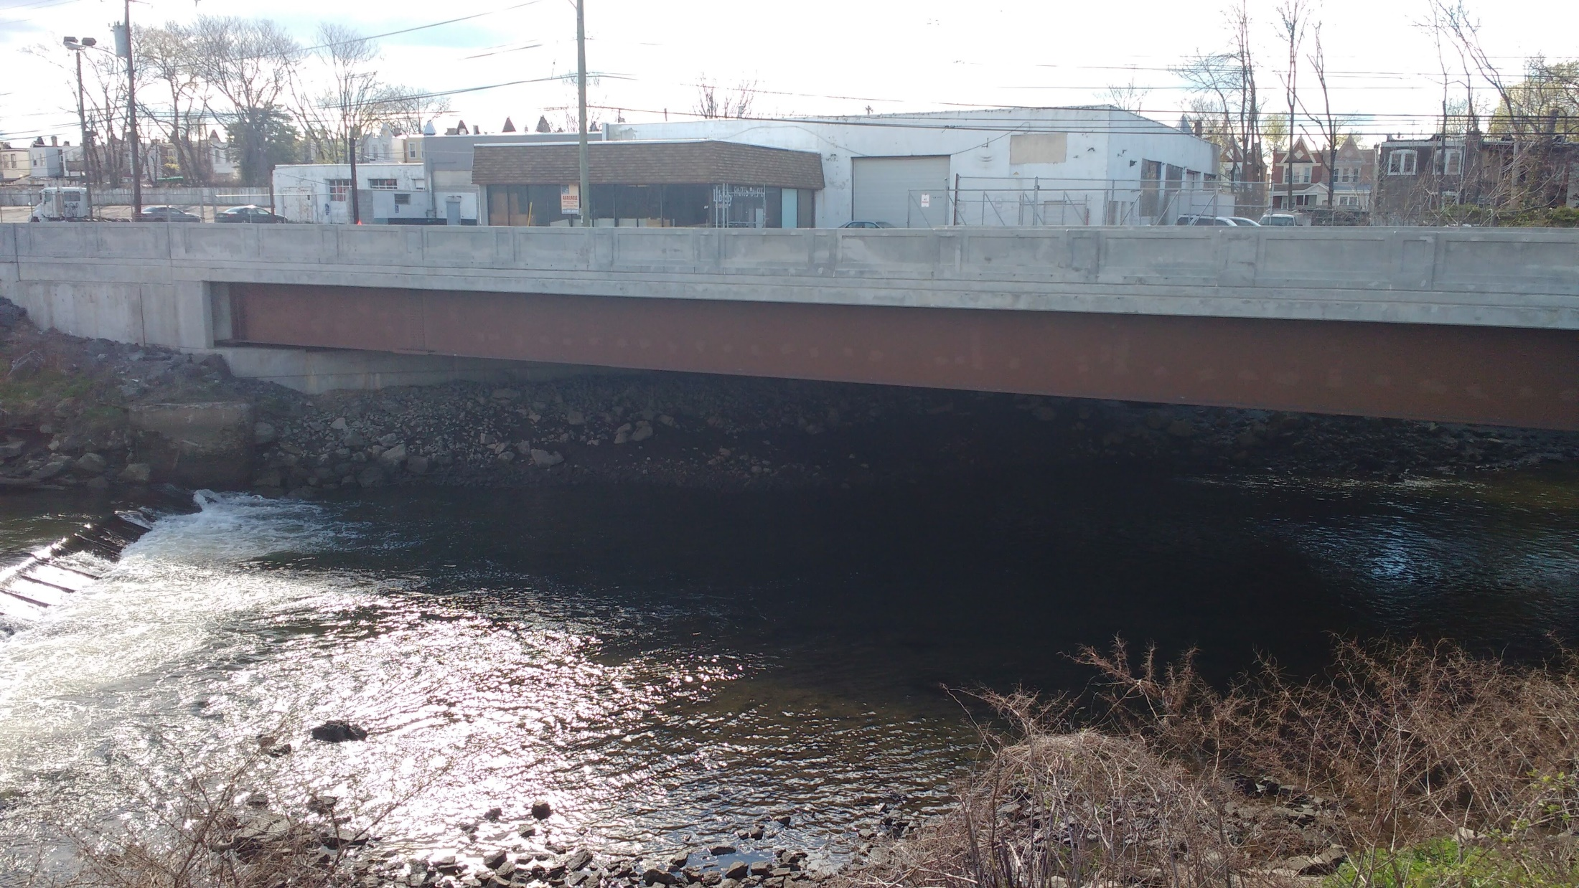
THMPR™

Slide 8
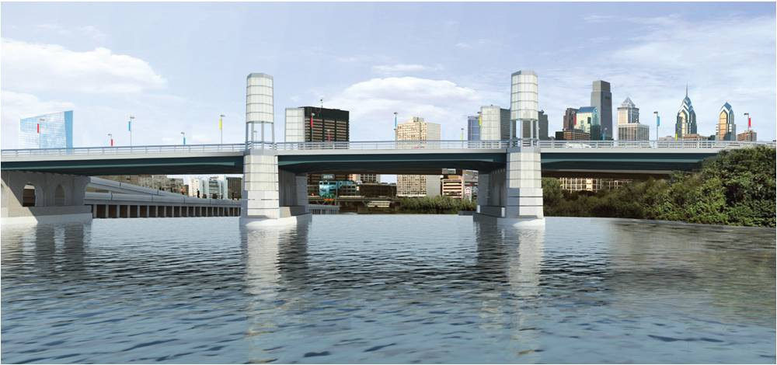
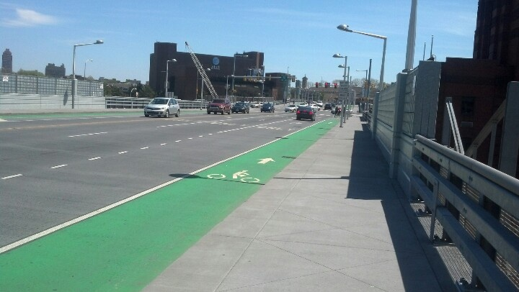

Slide 9
